Slide 1
Sampling
Populations and Samples
Data Sciences Institute, University of Toronto

Slide 2
Today, we will...
Probability vs Non-probability sampling
Sampling Types and Sample Design
Observational Studies and Censuses

Slide 3
Survey Populations

Slide 4
Survey Population
Survey Population: a real or hypothetical set of units with characteristics and attributes which can be modeled by random variables and their respective probability distributions.
Can be finite or infinite
Infinite: The population of all outcomes of repeated coin flips
Finite: The population of all people living in Toronto
Survey sampling deals with finite populations
Examples: The population of all adult Canadians (age 18+), The population of all adult Canadians who are regular smokers, The population of all full-time college students in Ontario, The population of all children aged 6–12 (inclusive) who attend public schools in the Greater Toronto Area.

Slide 5
Eligibility Criteria
Eligibility criteria for inclusion or exclusion of individuals are used to define survey populations
These inclusion or exclusion criteria must be clearly defined
When we say our population is youth in Canada, what do we mean by “youth”?
When we say we want to study regular smokers, what do we mean by “regular”? (Once a day? Once a week?)

Slide 6
Recall: Target, Frame, and Sample Populations
Target Population: the set of all units covered by the main objective of the study.
Frame Population: the set of all units covered by the sampling frame.
Sampled Population: the population represented by the survey sample.

Slide 7
Recall: Target, Frame, and Sample Populations
Target Population
Sampling Frame Population
Not reachable
Not included in sampling frame
Refuse to respond
Sample
Not eligible for survey
Not capable of responding

Slide 8
Population Structures and
Sampling Frames

Slide 9
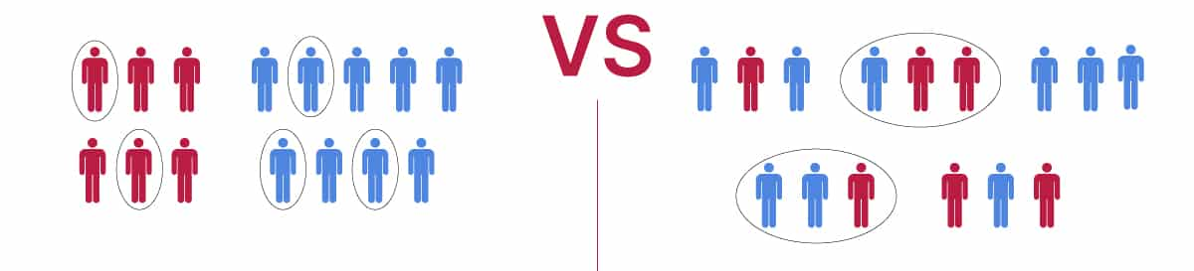
Population Structures
We can structure our populations in two primary ways: stratification and clustering
Both involve separating our population into groups called strata or clusters so that every individual in our population belongs to only one group
Stratified sampling ⇨ sample data are collected from every stratum
Cluster sampling ⇨ sample data are collected from only some clusters
Stratification Clustering

Slide 10
Activity: Stratification
What kind of stratification variable(s) would you use for each of the following situations? (AKA You want to do stratified sampling, what strata would you divide the population into?)
A political poll to estimate the percentage of registered voters in Arizona that approve of the governor’s performance.
A sample of public libraries in Ontario to study the availability of computer resources, and the per capita expenditures.
An aerial survey to estimate the number of walrus in the pack ice near Alaska between 173 degrees East and 154 degrees West longitude.

Slide 11
Statistical Units and Sampling Frames
Observational units are the individuals within the survey population
Sampling units are the units used for selecting the survey sample
Sampling units could be individuals (i.e. the same as observational units) or they might be clusters within the population
The sampling frame is the list of all sampling units for a given population
Example: for a university population, the sampling frame could be a list of all student emails (individual), or a list of all departments within the university (clusters) as long as each student belongs to only one department

Slide 12
Survey Samples

Slide 13
Censuses
A census is a survey or study conducted on every observational unit within a finite target population.
A census allows you to measure population quantities exactly (instead of calculating estimates based on samples).
Why not use a census all the time?

Slide 14

Censuses are high cost
Censuses take time
We can still accurately represent a population using a well-designed survey sample

Slide 15
Survey Samples
A survey sample, denoted by S, is a subset of the survey population U:
S = {i₁, i₂,..., i_{n}} ⊆ U,
where n is the sample size and i₁, i₂,..., i_{n} are the distinct labels for the n units in the sample.
We can take probability and non-probability sampling approaches.

Slide 16
Two Types of Sampling
Probability sampling = entire target population has a chance of being randomly selected; results can represent the whole population
Non-probability sampling = non-random selection (some in target population have no chance of selection); not generalizable but more convenient

Slide 17
Probability Samples
Every sampling unit has a chance to be included in our sample (a known selection probability)
We can calculate the probability of any one sample unit being in the sample
Non-response must be random
Samples are representative with minimal bias (we can generalize to a whole population)
Analysis, estimation, and inference are straightforward

Slide 18
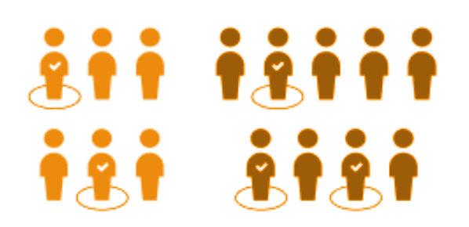
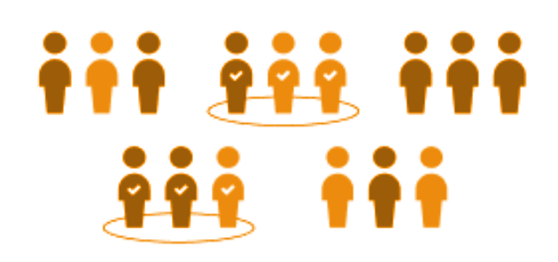
Types of Probability Samples
Stratified Sampling
Population is divided into groups called ‘strata’, then a proportionate number is taken from each stratum.
Cluster Sampling
The population is divided into clusters, a set of clusters are randomly selected, then every individual in the chosen clusters is included in the sample.

Slide 19
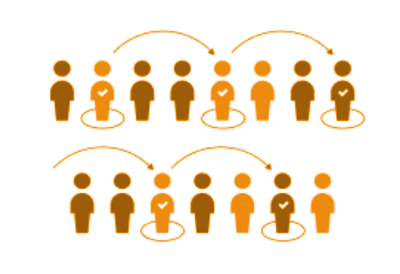
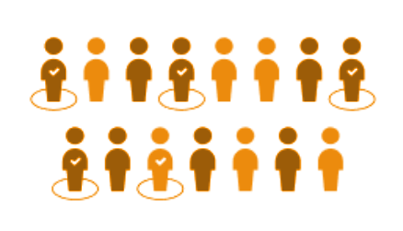
Types of Probability Samples
Simple Random Sampling
Numbers are assigned to individuals in the population and randomly selected from sampling. Any group of N individuals is as likely to be chosen as any other group of N individuals.
Systematic Sampling
Sampling from a random starting point and then in fixed intervals.

Slide 20
Multi-Stage Sampling
Like cluster sampling or stratified sampling followed by an additional stage of simple random sampling
Example: We stratify our school into grades, then we select a proportionate level of classrooms from each grade (stratified sampling), and then within each classroom, we randomly select students (simple random sampling)
Important: Each stage must involve a probability sampling method

Slide 21
Non-Probability Survey Samples
Selecting units for our sample based on availability or some purpose → some of our population has no chance of being chosen for our sample and we don’t know the exact portion we’re excluding
Means we can’t estimate how much our sample is really representative of our population

Slide 22
Types of Non-Probability Samples
Convenience sampling: sampling restricted to parts of the population that are readily accessible or to people who volunteer
Quota sampling: interviewers are selected and required to sample a certain number of people with certain types of characteristics.
Judgement or purposive sampling: sample is selected based on the judgement of the sampler about what is most-representative or most useful of the population.
Snowball sampling: Participants recruit other participants and so on until it ‘snowballs’

Slide 23
Activity: Identifying Sampling Methods

Slide 24

Activity
Name the sampling method used in each of the following situations:
A man in the airport is handing out questionnaires to travelers asking them to evaluate the airport’s service. He does not ask travelers who are hurrying through the airport with their hands full of luggage, but instead asks all travelers who are sitting near gates and not taking naps while they wait.

Slide 25

Activity
Name the sampling method used in each of the following situations:
A teacher wants to know if her students are doing homework, so she randomly selects rows two and five and then calls on all students in row two and all students in row five to present the solutions to homework problems to the class.

Slide 26

Activity
Name the sampling method used in each of the following situations:
The marketing manager for an electronics chain store wants information about the ages of its customers. Over the next two weeks, at each store location, 100 randomly selected customers are given questionnaires to fill out asking for information about age, as well as about other variables of interest.

Slide 27

Activity
Name the sampling method used in each of the following situations:
The librarian at a public library wants to determine what proportion of the library users are children. The librarian has a tally sheet on which they mark whether books are checked out by an adult or a child. They record this data for every fourth patron who checks out books.

Slide 28
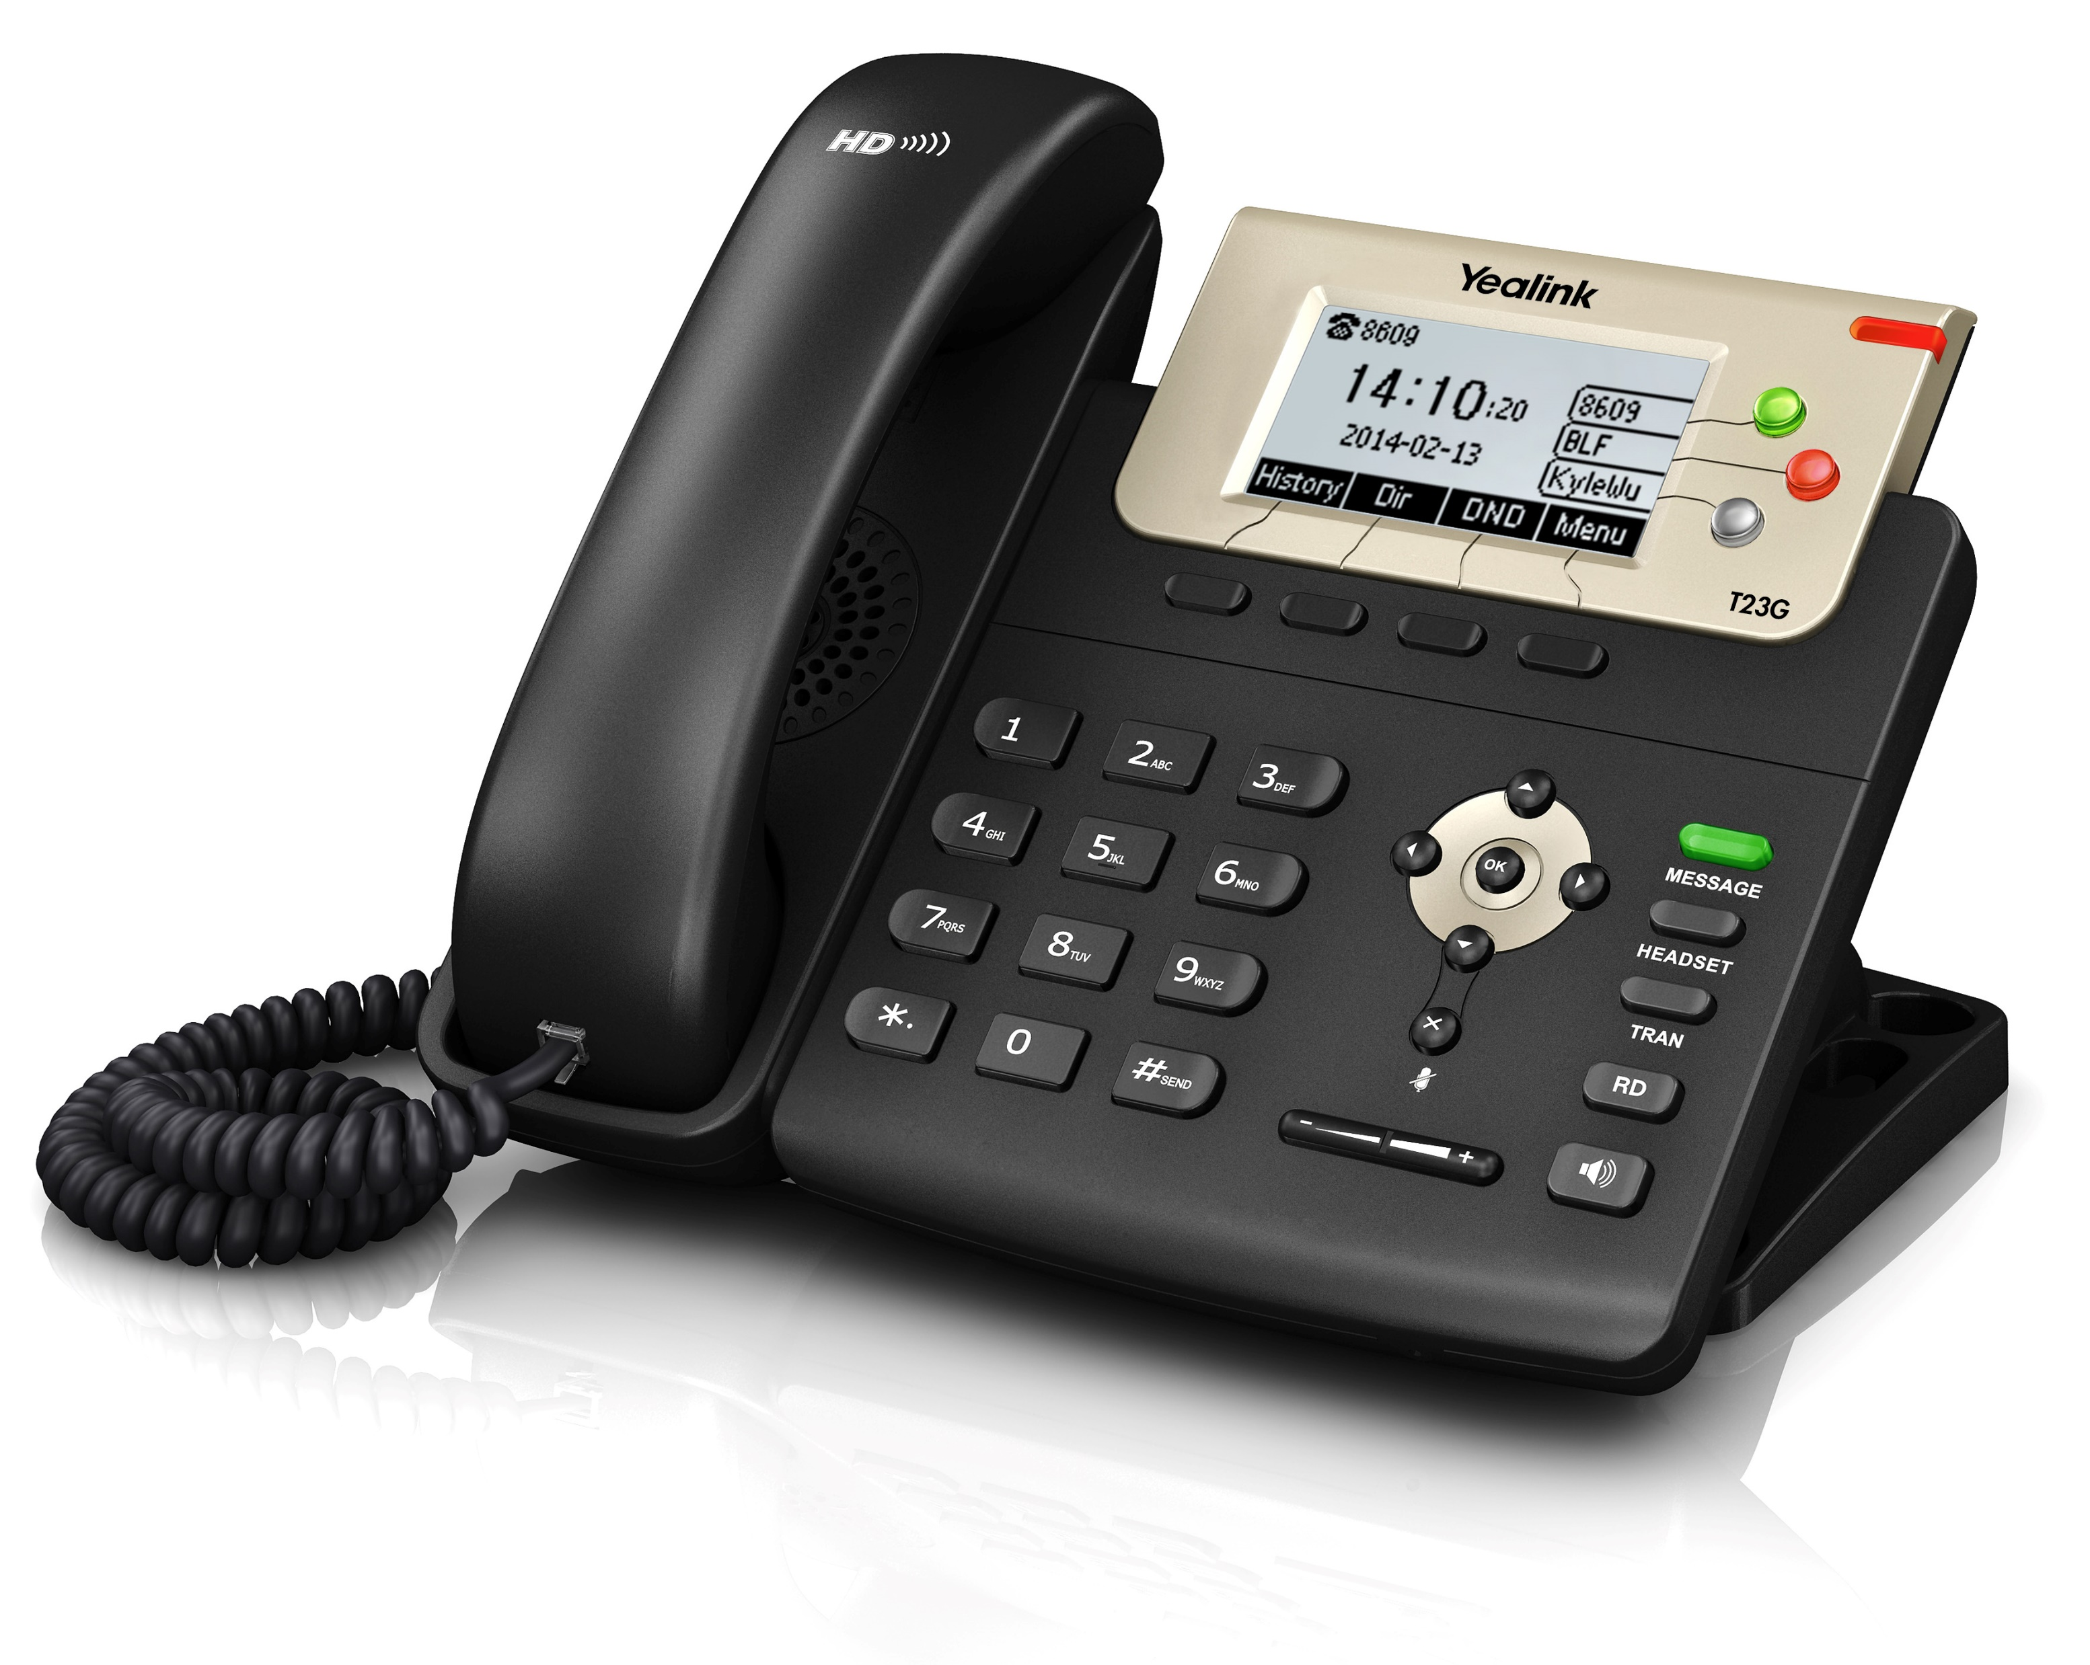
Activity
Name the sampling method used in each of the following situations:
A political party wants to know the reaction of voters to a debate between the candidates. The day after the debate, the party’s polling staff calls 1,200 randomly selected phone numbers. If a registered voter answers the phone or is available to come to the phone, that registered voter is asked who they intend to vote for and whether the debate changed their opinion of the candidates.

Slide 29
Activity (A new one!)
Let’s say there’s an election for prime minister coming up and we as political researchers want to find out which candidate Toronto voters like the best. Assuming we want to give our survey to a sample rather than the entire voting population, what might it look like to collect a simple random sample, a systematic sample, a cluster sample, and a convenience sample? What are some drawbacks or considerations of each approach?

Slide 30
Observational Studies

Slide 31
Observational Studies
An observational study constitutes observing a social system without intervening (i.e. without changing individuals’ behaviour)
Surveys can be thought of as a type of observational study, although often they are considered separately (is administering a survey an intervention?)
Observational data includes sources like government or academic records, images, or newspaper articles.
In the context of big data, it could also include digital sources like Facebook, Twitter, or Google activity logs.

Slide 32

Surveying vs. Observing
Many observational data sources contain inaccuracies or are incomplete
Key qualitative traits like emotions, opinions, or knowledge are difficult to assess through observational studies
Surveying and observational data can often be complementary when used together!

Slide 33
Linking Surveys to Observation Data
Enriched Asking: A big data set is missing certain measurements, which are then collected by surveying and linked to the original data
Record linkage can be difficult
Quality of original data source may be difficult to assess
Amplified Asking: A researcher trains a prediction model using survey data collected from a small number of respondents plus their corresponding records from a big data set, then uses the model to predict responses to survey questions for all individual records in the original data set
Faster and cheaper than large-scale surveys
However, currently lacks strong theoretical basis

Slide 34
Steps to Surveying (From Wu & Thompson, 2020)
A clear statement of the objectives of the survey.
Determination of the population to be sampled.
Determination of the relevant data to be collected.
Determination of the required accuracy of estimates.
Construction of sampling frames.
Choice of the sampling method.
Organization of the field work for data collection.
Plans for handling nonresponse.
Production of the survey dataset.
Summaries and analyses of the survey data.
Reports or publications on the study.

Slide 35
Next time..
Simple probability samples (errors, sample means, weights)
Systematic Sampling
Stratified sampling and quota sampling

